Slide 1



Generating Multilingual Variants for Automatically Extracted Sentiment Lexicons
The EUROSENTIMENT use-case
Gabriela Vulcu, Paul Buitelaar
Insight, Centre for Data Analytics, National University of Ireland, Galway
Notes:
We present a configurable pipeline for legacy language resource adaptation that generates entity-level domain-specific sentiment lexicons covering sentiment words that occur in the context of these entities. We explain the components of the pipeline and how it can be configured to work for different use cases, including but not only sentiment analysis. The pipeline includes also a component for generating translations, based on a Statistical Machine Translation approach and multilingual links from BabelNet. The resulting lexicons are modelled as Linked Data resources by use of established formats for Linguistic Linked Data and Linked Sentiment Expressions (lemon, Marl).
In the hands-on session the attendees will be able to use some of the pipeline components for generating and exploring example lexicons from their own data (basic text corpus).
From Legacy Language Resources to Interconnected Linguistic Linked Data Resources

Slide 2
Outline
EUROSENTIMENT overview
Legacy Language Resources
Pipeline for Language Resource Adaptation
Tools and Demos

Slide 3
EUROSENTIMENT: problems addressed
Overall problems
  lack of agreed schemas for sentiment analysis (e.g. no agreed sentiment strength)
  lack of visibility, accessibility of sentiment analysis language resources
Addressed problems
  high costs for adapting sentiment analysis resources to new domains, languages
  lack of interoperability with other language or semantic resources like the Linguistic Linked Open Data cloud (LLOD)
Notes:
In recent years, there has been a high increase in the use of commercial websites, social networks and blogs which permitted users to create a lot of content that can be reused for the sentiment analysis task.

Slide 4
EUROSENTIMENT: objectives
Overall objectives
  Create a market for language resources by setting up a shared language resource pool (LRP)
  Putting in place best-practice guidelines, QA procedures for the LRP
  Demonstrate the impact of the LRP in multilingual sentiment analysis applications
Addressed objectives
  Reduce the cost of creating, adapting sentiment language resources by using the LRP
  Provide semantic interoperability between multilingual sentiment analysis language resources

Slide 5
Outline
EUROSENTIMENT overview
Legacy Language Resources
Pipeline for Language Resource Adaptation
Tools and Demos

Slide 6
Heterogeneity of Existing Language Resources
Format
  plain text
  HTML, XML, EXCEL, TSV, CSV, RDF/XML
  with or without custom made annotations,
Annotations
  domain, language
  entities, lemma, POS, WordNet synset
  sentiment
  emotion
  inflections
Notes:
domain - the broad context of the review corpus (i.e. ’hotel’ is the domain for the TripAdvisor corpus);
language - the language of the language resource;
context entities - relevant entities in the corpus;
lemma - lemma annotations of the relevant entities;
POS - part-of-speach annotations of the relevant entities;
WordNet synset - annotations with existing synsets from Wordnet of the relevant entities;
sentiment - positive or negative sentiment annotation both at sentence level and or at entity level;
emotion - more fine grained polarity values both expressed as numbers or as concepts from well defined ontologies; (Ekman anger, disgust, fear, happiness, sadness, and surprise.)
inflections – morphosyntactic annotations of the relevant entities.

Slide 7

Example: TripAdvisor hotels dataset
<Author>kekeScotland
<Content>We got a good deal compared to other Madrid prices and as we were only using the hotel as a base so we didn't expect too much. Location of the Alberto Aguilera NH hotel was pretty good and the room was quiet and clean. We had a safe and free wi-fi. Only downside was the room was on the small side and the bathroom was tiny.
<Value>3
<Rooms>4
<Location>5
<Cleanliness>4
<Check in / front desk>1
<Service>3
<Business service>4
<Date>Sep 10, 2008
<No. Reader>-1
<No. Helpful>-1
<Overall>4

Slide 8
Polarity of specific aspects
<Author>kekeScotland
<Content>We got a good deal compared to other Madrid prices and as we were only using the hotel as a base so we didn't expect too much. Location of the Alberto Aguilera NH hotel was pretty good and the room was quiet and clean. We had a safe and free wi-fi. Only downside was the room was on the small side and the bathroom was tiny.
<Value>3
<Rooms>4
<Location>5
<Cleanliness>4
<Check in / front desk>1
<Service>3
<Business service>4
<Date>Sep 10, 2008
<No. Reader>-1
<No. Helpful>-1
<Overall>4

Slide 9

Example: a different format
qmazon electronics dataset
[ t ] the best 4mp compact digital available
camera[+2]## this camera is perfect for an enthusiastic amateur photographer .
picture[+3], macro[+3]## the pictures are razor-sharp , even in macro . . .
Notes:
The annotation [t] stands for the title of the review whereas the numbers in brackets stand for the rating of a certain aspect in the review.

Slide 10
Aspect polarity and entities annotations
Amazon electronics dataset
[ t ] the best 4mp compact digital available
camera[+2]## this camera is perfect for an enthusiastic amateur photographer .
picture[+3], macro[+3]## the pictures are razor-sharp , even in macro . . .
Notes:
The annotation [t] stands for the title of the review whereas the numbers in brackets stand for the rating of a certain aspect in the review.

Slide 11

Proprietary formats
Paradigma dataset
0 10 en PIZZA HUT/PIZZA HUT There::there::EX;;are::be::VBP;;local::local::JJ;;places::place::NNS;;that::that::WDT;;are::be::VBP;;far::far::RB;;better::good::JJR;;,::,::Fc;;but::but::CC;;compared::compare::VBN;;to::to::TO;;Pizza::pizza::NN;;Hut::hut::NN;;or::or::CC;;Dominos::domino::NNS;;it::it::PRP;;wins::win::VBZ;;.::.::Fp
positive

Slide 12
Lemma, POS, overall polarity
Paradigma dataset
0 10 en PIZZA HUT/PIZZA HUT There::there::EX;;are::be::VBP;;local::local::JJ;;places::place::NNS;;that::that::WDT;;are::be::VBP;;far::far::RB;;better::good::JJR;;,::,::Fc;;but::but::CC;;compared::compare::VBN;;to::to::TO;;Pizza::pizza::NN;;Hut::hut::NN;;or::or::CC;;Dominos::domino::NNS;;it::it::PRP;;wins::win::VBZ;;.::.::Fp
positive

Slide 13
Outline
EUROSENTIMENT overview
Legacy Language Resources
Pipeline for Language Resource Adaptation
Tools and Demos

Slide 14
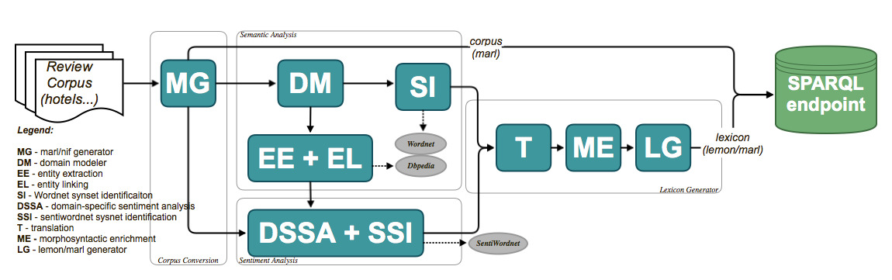
Pipeline for Language Resource Adaptation
domain-specific sentiment lexicon generation
entity extraction for aspect-based sentiment analysis
sentiment analysis in the context of entities
lexicons are modeled using lemon
sentiments are modeled using Marl
Notes:
lexicons are modeled as Linked Data resources by use of established formats for Linguistic Linked Data (lemon, NIF) and for linked sentiment expressions (Marl), thereby contributing and linking to existing Language Resources in the Linguistic Linked Open Data cloud.

Slide 15
Corpus Conversion
adapts sentiment corpora to a common schema (NIF, Marl)
Notes:
The Corpus Conversion step adapts corpus resources to a common schema. We defined a schema based on the NIF and Marl formats that structures the annotations from the corpora reviews.
The NLP Interchange Format (NIF) is an RDF/OWL-based format that aims to achieve interoperability between Natural Language Processing (NLP) tools, language resources and annotations.

Slide 16
Example: Corpus Conversion
"entries": [ {
"nif:String": “We got a good deal compared to other Madrid prices and as we were only using the hotel as a base so we didn't expect too much. Location of the Alberto Aguilera NH hotel was pretty good and the room was quiet and clean. We had a safe and free wi-fi. Only downside was the room was on the small side and the bathroom was tiny.",
"dc:language": "en",
"prov:wasDerivedFrom": {
” @type": "es:TripadvisorComment”,
"date": "2008-09-10",
"user": "kekeScotland” },
"opinions": [ {
"@id": "_:Opinion01",
"marl:hasPolarity": "marl:Positive",
"marl:polarityValue": 4,
"marl:describesObjectFeature": "Overall”},
…}]
… }]

Slide 17
Example: Corpus Conversion
"entries": [ {
"nif:String": “We got a good deal compared to other Madrid prices and as we were only using the hotel as a base so we didn't expect too much. Location of the Alberto Aguilera NH hotel was pretty good and the room was quiet and clean. We had a safe and free wi-fi. Only downside was the room was on the small side and the bathroom was tiny.",
"dc:language": "en",
"prov:wasDerivedFrom": {
” @type": "es:TripadvisorComment”,
"date": "2008-09-10",
"user": "kekeScotland” },
"opinions": [ {
"@id": "_:Opinion01",
"marl:hasPolarity": "marl:Positive",
"marl:polarityValue": 4,
"marl:describesObjectFeature": "Overall”},
…}]
… }]

Slide 18
Example: Corpus Conversion
"entries": [ {
"nif:String": “We got a good deal compared to other Madrid prices and as we were only using the hotel as a base so we didn't expect too much. Location of the Alberto Aguilera NH hotel was pretty good and the room was quiet and clean. We had a safe and free wi-fi. Only downside was the room was on the small side and the bathroom was tiny.",
"dc:language": "en",
"prov:wasDerivedFrom": {
” @type": "es:TripadvisorComment”,
"date": "2008-09-10",
"user": "kekeScotland” },
"opinions": [ {
"@id": "_:Opinion01",
"marl:hasPolarity": "marl:Positive",
"marl:polarityValue": 4,
"marl:describesObjectFeature": "Overall”},
…}]
… }]

Slide 19
Semantic Analysis
entity class extraction (hotel)
named entity extraction (Alberto Aguilera NH)
linking to LOD (DBpedia) and LLOD cloud (WordNet, BabelNet)
Notes:
The DM extracts a set of entity class using a pattern-based term extraction algorithm with a generic domain model (Bordea, 2013) on each document, aggregates the lemmatized terms and computes their ranking in the corpus(Bordea et al., 2013).
The EE and EL components are based on AELA (Pereira et al., 2013) framework for Entity Linking that uses a Linked Data dataset as reference for entity mentioning identification, ex- traction and disambiguation.
The SI identifies and disambiguates WordNet synsets that match with the extracted entity classes. It extends each candidate synset with their direct hyponym and hypernym synsets. Then we compute the occurrence of a given entity class in each of these bag of words. We choose the synset with the highest occurrence score for an entity class.

Slide 20
Example: Entities and Entity Classes Extraction
“We got a good deal compared to other Madrid prices and as we were only using the hotel as a base so we didn't expect too much. Location of the Alberto Aguilera NH hotel was pretty good and the room was quiet and clean. We had a safe and free wi-fi. Only downside was the room was on the small side and the bathroom was tiny. "
Entity class | Dbpedia link | WordNet link
deal | http://dbpedia.org/resource/Deal | http://wordnet-rdf.princeton.edu/wn31/1110274-n
location | http://dbpedia.org/resource/Location_(geography) | http://wordnet-rdf.princeton.edu/wn31/27167-n
hotel | http://dbpedia.org/resource/Hotel | http://wordnet-rdf.princeton.edu/wn31/3542333-n
room | http://dbpedia.org/resource/Room | http://wordnet-rdf.princeton.edu/wn31/4105893-n
wi-fi | http://dbpedia.org/resource/Wi-fi | N/A
bathroom | http://dbpedia.org/resource/Bathroom | http://wordnet-rdf.princeton.edu/wn31/2807731-n
Named Entity | Dbpedia link | WordNet link
Madrid | http://dbpedia.org/resource/Madrid | http://wordnet-rdf.princeton.edu/wn31/9024467-n
Alberto Aguilera NH | N/A | N/A

Slide 21
Sentiment Analysis
extract sentiment words in the context of the identified entities
linking to LLOD (SentiWordNet)
Notes:
The DSSA component identifies a set of sentiment words and their polarities in the context of the entities identified in the Semantic Analysis step. The clause in which a entity mention occurs is considered the span for a sentiment word/phrase in the context of that entity. The DSSA is based on earlier research on sentiment analysis for identifying adjectives or adjective phrases (Hu and Liu, 2004), adverbs (Benamara et al., 2007), two- word phrases (Turney and Littman, 2005) and verbs (Sub- rahmanian and Reforgiato, 2008).
Particular attention is given to the sentiment phrases which can represent an opposite sentiment than what they represent if separated into individual words. For example, ’ridiculous bargain’ represents a positive sentiment while ’ridiculous’ could rep- resent a negative sentiment. Sentiment words/phrases in individual reviews are assigned polarity scores based on the available user ratings. In case of language resources with no ratings we use a bootstrapping process based on Sentiwordnet that will rate the domain aspects in the review. We select the most frequent scores as the final sentiment score for a sentiment word/phrase candidate based on its occurrences in all the reviews.
The SSI component identifies SentiWordNet synsets for the extracted contextual sentiment words. The sentiment phrases however, are not assigned any synset. Linking the sentiment words with those of SentiWordNet further enhances their semantic information. We identify the nearest SentiWordNet sense for a sentiment candidate using Concept-Based Disambiguation (Raviv and Markovitch, 2012) which utilizes the semantic similarity measure ’Explicit Semantic Analysis’ (Gabrilovich and Markovitch, 2006) to represent senses in a high-dimensional space of natural concepts. Concepts are obtained from large knowledge resources such as Wikipedia, which also covers domain specific knowledge. We compare the semantic similarity scores obtained by computing semantic similarity of a bag of words containing domain name, entity and sentiment word with bags of words which contain members of the synset and the gloss for each synset of that SentiWordNet entry. The synset with the highest similarity score above a threshold is considered.

Slide 22
Example: Sentiment Analysis
<Author>kekeScotland
<Content>We got a good deal compared to other Madrid prices and as we were only using the hotel as a base so we didn't expect too much. Location of the Alberto Aguilera NH hotel was pretty good and the room was quiet and clean. We had a safe and free wi-fi. Only downside was the room was on the small side and the bathroom was tiny.
<Value>3
<Rooms>4
<Location>5
<Cleanliness>4
<Check in / front desk>1
<Service>3
<Business service>4
<Date>Sep 10, 2008
<No. Reader>-1
<No. Helpful>-1
<Overall>4
Notes:
Mapping: Entity mention - Sentiment word/phrase - Rating Field

Slide 23
Example: Sentiment Words
“We got a good deal compared to other Madrid prices and as we were only using the hotel as a base so we didn't expect too much. Location of the Alberto Aguilera NH hotel was pretty good and the room was quiet and clean. We had a safe and free wi-fi. Only downside was the room was on the small side and the bathroom was tiny. "
Sentiment Word | Entity | Sentiment Score | WordNet link
good | deal | 1 | http://wordnet-rdf.princeton.edu/wn31/1123148-a
pretty good | location | 0.75 | N/A
pretty good | Alberto Aguilera NH | 0.75 | N/A
quiet | room | 0.75 | http://wordnet-rdf.princeton.edu/wn31/1922763-a
clean | room | 0.90 | http://wordnet-rdf.princeton.edu/wn31/417413-a
small | room | -0.50 | http://wordnet-rdf.princeton.edu/wn31/1391351-a
tiny | bathroom | -1 | N/A
free | wi-fi | 0.95 | http://wordnet-rdf.princeton.edu/wn31/1061489-a
safe | wi-fi | 0.80 | http://wordnet-rdf.princeton.edu/wn31/2057829-a

Slide 24
Lexicon Generator
translate entity classes, sentiment words for multilingual analysis
enrich with morphosyntactic information (CELEX)
convert to lemon and Marl format
Notes:
lexicons are modeled as Linked Data resources by use of established formats for Linguistic Linked Data (lemon, NIF) and for linked sentiment expressions (Marl), thereby contributing and linking to existing Language Resources in the Linguistic Linked Open Data cloud.

Slide 25
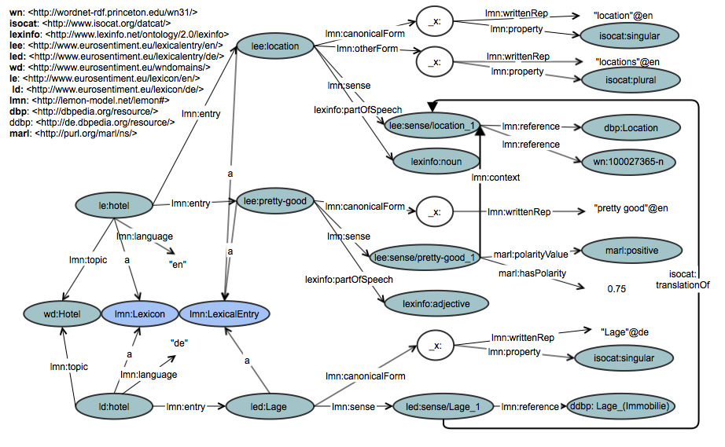
Resulting lexicons (en, de)

Slide 26
Resulting lexicons (en, de)
Notes:
2 lexicons: one for en and one for de

Slide 27
Lexical entries
Notes:
3 lexical entries: one entity, one sentiment word and one translation

Slide 28
Lexical entry: morphosyntactic info
Notes:
Links to LOD: Dbpedia and Wordnet

Slide 29
Lexical entry: DBpedia and WordNet links
Notes:
Links to LOD: Dbpedia and Wordnet

Slide 30
Sentiment polarities using Marl
Notes:
For sentiment words, besides the link to LOD we have also polarity info.

Slide 31
Sentiments with context
Notes:
The sentiment word is connected to the context in which it appears.

Slide 32
German lexicon obtained from translation
Notes:
The translation link to the original entity in english.

Slide 33
Outline
EUROSENTIMENT overview
Legacy Language Resources
Pipeline for Language Resource Adaptation
Tools and Demos

Slide 34
Available tools and demos
Language resources RDF interface:
  http://www.eurosentiment.eu/dataset
Sparql endpoint
  http://portal.eurosentiment.eu/sparql_demo
Resources Navigator
  http://portal.eurosentiment.eu/lr_navigator_demo

Slide 35
Sparql demo steps
1. Show the sentiments used with various domain aspects (electronics, en).
* domain aspects: CRT_screen, CPU
* sentiments: easy, fast, flying
* sentiment polarities
2. Show domain aspects (hotel, en)
* staff, service, housekeeping
3. Show top sentiment words (hotel, en)
* good, great, neat, bully
4. Show positive sentiments (hotel, it)
* bello, carino

Slide 36
Sparql demo steps (contd.)
5. Show negative sentiments (electronics, fr)
* difficile, problème, cher
6. Show links to Dbpedia and WordNet
* electronics, en, experience
7. Show translations from BableNet
* hotel, en, RO
8. Show translations from the MT approach
* hotel, really-confortable, DE
* clear-and-readable, ES

